Slide 1
Business Context
SWEN-440

Slide 2
Why Does Software Get Built?

Slide 3
Essential Business Requirements
Projects are launched when the value of solving recognized problems exceeds the cost of doing so.
  To solve a specific problem
      Not just because we can — even hobby projects have a purpose (e.g. Linux)
  At a cost the value justifies
      Cost = money, time, opportunity — not just budget
  Requirements & architecture drive cost
      Understanding the business context is not optional — it shapes every decision
    Yes, Software Engineering requires business awareness as well

Slide 4
Understand Business Context
Minimally:
  Understand the application domain
      What kind of business?
        McDonald’s – fast food or franchising?
      e.g. healthcare? HIPAA is assumed
      e.g. e-commerce? Conversion rate & payment integrations – critical
      Invest time in understanding domain, terminology, regulations, …
  Identify stakeholders
      Missing stakeholder may result in massive rework
        We built a system & legal department blocked everything

Slide 5
Understand Business Context
Minimally:
  Project priorities
        Drivers – significant success objectives;
          e.g. profit margin
            System cost – primary concern
        Constraints – limiting factors
          e.g. launch before Christmas
            Competitors will ship by then
            Date-specific products need to be available
            Non-negotiable constraints → architecture should accommodate
        Degree of freedom: factors that can balance constraints and drivers;
          Trade-off space (sacrifices)
          e.g. time constraints → buy a service → cost is up
          e.g. need iOS app → native or cross-platform?

Slide 6
Understand Business Context
Minimally:
  Operating environment
        User environment – how and where the system will be used?
          e.g. call-center support in noisy offices – UI must minimize data entry error
          e.g. doctors with tablets visit patients – system design decisions
            Touch interfaces
            Connectivity
            Security
        Deployment environment – hardware & infrastructure context
          e.g. on-premise in secure intranet
            No external API calls → cannot rely on external services
          e.g. AWS deployment
            High availability is easier to achieve → different cost/availability trade-offs than on-premise
Notes:
System design decisions:
Touch interface
Offline work
Synchronization

Slide 7
Business Drivers
Market share, competition
  Gain / protect market share
    e.g. all competitors have this
    e.g. we need to have it first
  Need to do fast
Product lines
  Missing products
  Need to integrate into current ones
Global markets
  Localization (languages, laws, etc)
  Need to reshape some architecture aspects
Revenue
  Need to minimize costs OR introduce new cost models, e.g. subscription

Slide 8
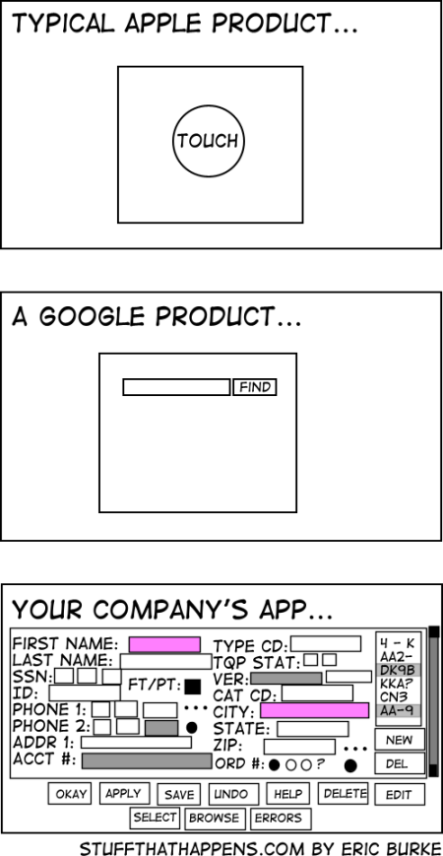
Business Drivers
Cost to develop, deploy, operate, and maintain
  Need to minimize costs
Personnel objectives
  e.g. Increase staff effectiveness
  e.g. increase staff retention
  Need to improve usability & simplicity (internal systems)
Liability, safety, reputation
  Need a bullet-proof solution
  #1 in customer service
Standards and regulations
Intellectual property
Environmental and sustainability concerns

Slide 9
Stakeholders
What is a Stakeholder?
  Not just the Product Owner (PO) / client
  Any individual or organization which is actively involved in, materially affected by, or influences the outcome of the system
Consider a hospital appointment system
Stakeholder | Interest
Patients | Use the system
Nurses & Doctors | Workflow depends on it
Development Team | Build, maintain, evolve the system
Cleaning Staff | Not affected in any way
Data Protection Officer | Can stop the project if data not handled correctly
Failure to identify all stakeholders can have costly consequences

Slide 10
Stakeholders
360 degrees of
perspective
Business Problem
primary concern map
Customers
Managers
Users
Analysts
Investors
Deployment
Development
Technical Writers
Developers
Service Providers
Testers
Maintainers
Conflicting interests:
Patients – same-day booking
Doctors – predictable schedule
Technical Solution

Slide 11
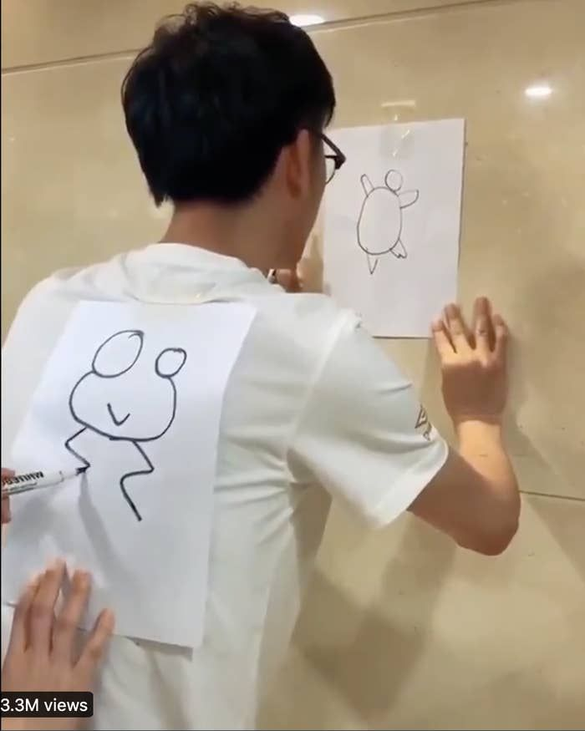
Formulate a Vision, Understand Scope
Before architecting
  Gain a full understanding & alignment
    Stakeholders agree on WHAT problem is being solved
  Or else
    Project drifts
    System solves a different problem
  e.g.
    Built: bank app with gamification
    Customers wanted: fast balance check
    Wasted: millions of $$$
    Why: ignored customers’ interests

Slide 12
Formulate a Vision, Understand Scope
Solution – Vision & Scope document
Gain understanding and agreement with the stakeholders on …
  Problem – the business opportunity or problem to be addressed
    Describe the impact on the business, not just the symptom
    Good: online orders fail during peak hours, causing revenue loss
    Bad: our monolith is not scalable → orders lost in peak hours → money loss
      Why is this one bad?
  Purpose – what the system is intended to do to address the problem
    e.g. ensure reliable online ordering [by improving scalability & fault tolerance – passable (edges toward tech solution)]
    The "what" not the "how" - no tech details
  Vision – long-term strategic purpose and intent of the system
    Good: provide excellent shopping experience across all devices, becoming #1 service
    Bad: in sprint 1, we…
    Vision outlasts the project
      Design where the system is going, not just where it starts
Notes:
It's bad because it frames the problem in implementation terms (technical symptom), not business terms

Slide 13
Formulate a Vision, Understand Scope
Solution – Vision & Scope document
Gain understanding and agreement with the stakeholders on …
  Scope – long-term vision’s part to be addressed now
    Vision: excellent shopping experience across all devices, becoming #1 service
    Scope:
      Mobile app for the US only
      Payment integrations
      Real-time inventory
    What to build & what NOT to build
    Avoid scope creep
  System Boundary (scope) – the boundaries of the problem and solution
    Inside: driver app, rider app, matching algorithms
    Outside: payment gateway (integrated), Google Maps (integrated)
    Can we build a payment gateway? No – Compliance, security, and trust take years to build

Slide 14
Formulate a Vision, Understand Scope
Example:
  Problem: Long patient wait times due to manual check-in.
  Purpose: Provide patients with a self-service mobile check-in experience that avoids front-desk bottlenecks.
  Vision: Become the leading digital healthcare platform by delivering seamless patient experiences from scheduling through discharge.
  Scope: Support appointment booking and check-in, pilot in one hospital branch.
  Boundary: Payment and insurance processing handled by existing systems, not in scope.
  Reference point for every architectural decision.

Slide 15
Problem Statement
Characterize the business opportunity / problem
With the stakeholders (consensus!), formulate a problem statement:
  The problem of <describe the problem>
    No solutions / tech details
    Business focused
    Example keywords: lack of, inconsistency in, delay in, difficulty with, inability to, etc
  Affects <the stakeholders affected by the problem>
    Do not skip - missing affected parties means missed requirements later.
  The impact of which is <what is the impact of the problem>
    Negative consequences
    Why it matters (very briefly)
  A successful solution would <list some key benefits of a successful solution>
    What success looks like
    Don’t specify tech details!

Slide 16
Example Problem Statement
The problem of: subpar customer support
    Bad: customer service is bad – what is bad?
    Good: untimely and improper resolution of customer service issues
      Addresses specifics
Affects: our customers, customer support reps and service technicians.
The impact of which is: customer dissatisfaction, perceived lack of quality, unhappy employees and loss of revenue (give specific number if possible).
A successful solution would:
  Provide support reps real-time access to accurate information
  Facilitate dispatch of service technicians, in a timely manner only to those locations which genuinely need their assistance
    Some can be resolved by support reps

Slide 17
Example Problem Statement
The problem of untimely and improper resolution of customer service issues affects our customers, customer support representatives, and service technicians. The impact of which is customer dissatisfaction, a perceived lack of quality, unhappy employees, and an estimated $1.2M loss of annual revenue. A successful solution would enable support representatives to resolve issues quickly and consistently, and ensure service technicians are dispatched only to locations that genuinely require on-site assistance.

Slide 18
System Purpose
  Why THIS project is needed
    How it’s going to address the problem
    Not technology, but essence
Essence - fundamental purpose of the system to exists
  Should tie to the original problem statement!
  All requirements must serve this purpose – define a purpose well
Problem: bank clients cannot withdraw money when the office is closed
Purpose (ATM): let clients withdraw money at any time
  Essence: withdraw money from a bank account
  Implementation: cards, PINs, buttons, etc.
  Lots of technological solutions, but only one essence / essential goal
    e.g. replace cards by biometrics
      Different feature
      Same essence

Slide 19
System Purpose
  Check the scope against the purpose
  Problem: Patients need to check-in manually
  Purpose: Self check-in without staff assistance
  What was implemented:
    Chat
    Health articles
    Appointment calendar
    Insurance card storage
    Parking payments
  Did it serve the purpose?
    Was the purpose poorly defined, or was it ignored?

Slide 20
Purpose, Advantage, Measurement
Purpose: What the system will do
  Justify why resources should be spent
Advantage: What business advantage does it provide?
  e.g. ATM:
    Less tellers → Lower salary expenses
    Extended service hours → happy customers are happy → retention
    Customer convenience → retention
Measurement: How do you measure the advantage?
  40% less in-person withdrawals → fire 40% of tellers
  Customer happiness up by 13% → 7% less switch to other banks
[Robertson and Robertson]

Slide 21
Purpose, Advantage, Measurement
Why?
  You are C-level management
  Somebody tells you "I have a genius idea! Will save $1k per year!"
  You need to understand the profit & expenses & feasibility
Cost-benefit analysis!
  Reasonable? Is effort (cost) < advantage (value)?
    New portal costs $50k, but saves only $1k / year
  Feasible? Can the system achieve the measurement?
    Patient wait time from 40 minutes to 5 minutes? Really?...
  Achievable? Does the organization have (or can acquire) the skills to build and operate the system?
    Small startup building a cloud datacenter?..
Is the project practical?
[Robertson and Robertson]

Slide 22
Purpose, Advantage, Measurement (PAM) Example
Winter Road Maintenance system
  Purpose: Accurate forecasting road freezing times & dispatching de-icing trucks
  Advantage: Reduce road accidents by forecasting icy road conditions
  Measurement: Ice-caused accidents < 15% of accidents
Additional purpose
  Purpose: Save money on winter road maintenance costs
  Advantage: Reduced unnecessary de-icing
  Measurement: De-icing cost to be reduced by 25%
  You can approve or reject, what do you do? Why?
  Reasonable? Is cost < advantage?
  Feasible? Can the system achieve the measurement?
  Achievable? Can the company create & maintain the system?
[Robertson and Robertson]
Notes:
How much deicing cost in absolute numbers?
How much money will be saved on road maintenance?
How many accidents will be prevented?
How long there is ice on the road during a year?
GRE questions

Slide 23
Vision Statement of the Solution
1 project, 3 different teams, 3 different project understandings
    Same features are envisioned differently
Strategic vision for how the system will achieve business objectives
  Guides design and feature decisions throughout development — if a choice conflicts with the vision, it's rejected
  e.g. Kindle - "every book, ever printed, in any language, available in under 60 seconds."
    Vision emphasizes speed, won't prioritize a feature that slows down UX.

Slide 24
Vision Statement of the Solution
Template for a consensus among stakeholders
  For <customer> - primary beneficiary
    voters
  Who <problem statement(s)> - main pain points of beneficiaries
    Currently cannot cast votes outside of designated polling locations
  The <system name > - so we can reference it
    Tiger Voting Kiosk
  Is <system category> - brief idea what it is
    An electronic voting machine
  That <key benefits> - core advantage
    Will comply with all election laws, provide an easy-to-use interface, and be fully secure
  Unlike <existing or alternative solutions> - what are the current options
    Existing proprietary voting machines
  Our System <is an x that provides y> - how it is different
    Will redundantly record every vote on paper to enable recounts and prevent fraud

Slide 25
Vision Statement of the Solution
  For voters Who currently cannot cast votes outside of designated polling locations The Tiger Voting Kiosk Is an electronic voting machine That will comply with all election laws, provide an easy-to-use interface, and be fully secure Unlike existing proprietary voting machines Our System will redundantly record every vote on paper to enable recounts and prevent fraud.

Slide 26
Cautions
Functional requirements are from Problem statement/description Vision statement | FR withdraw money check account balance deposit money
Non-functional requirements (often implied) Often missed e.g. Security Performance Scalability | NFR ATM must encrypt PIN multi-language support availability > 99% per day 95% transactions < 5 seconds
“I didn’t write it down, but it’s obvious, isn’t it?” No, it’s not “WRITE IT DOWN”! | Skip FR – devs will ask Skip NFR – devs will ignore

Slide 27
System Scope Analysis
Scope – part of the long-term vision to be built right now
  e.g.
    Vision – become a world-class scientist & discover immortality
    Scope – graduate with a bachelor’s degree
    Current project – one step toward the vision
Not defined by business alone
  Dev team provides a reality check
  Negotiation between dev and business
  Balance between ambition (vision) and reality (resources)
  e.g.
    Business: real-time interplanetary video calls!
    Dev:
      Cannot do because physics & speed of light
      Let’s record and send video messages

Slide 28
System Scope Analysis
Project release plan - initial and subsequent release features
  Roadmap:
    MVP – list of features
    Release 2 – list of features
    …
    Release N – list of features
    (Ideally) With approximate dates / quarters / years
    Almost never goes perfectly
      Still better to have
      Adjust along the way
    e.g.
      Release 1 - balance inquiry, cash withdrawal, PIN authentication
      Release 2 - fund transfer, bill payment, SMS alerts
      Release 3 - personal finance insights, AI credit scoring

Slide 29
System Scope Analysis
Project release plan - initial and subsequent release features
  What drivers and constraints?
    Drivers – what pushes us forward
      e.g. market demand, technology shift
    Constraints – what’s holding us back
      e.g. budget, expertise, tech debt, regulations (could also be a driver)
  System product line strategy?
    Only one product vs part of a product line
    Different system design
      Mobile telecom vs mobile + landline + internet + public wi-fi + starlink
  System platform opportunities?
    Short vs long term investment
    Will we stop or extend later?
    Different design decisions

Slide 30
What Is The System, and What Isn't It?

Slide 31
System Thinking
What is the system?
  All of the inputs – data, events, etc.
    e.g. customer order & payment info
  All of the outputs – data, events, reports, etc.
    e.g. delivered food & receipt
  All of the logic that translates inputs into outputs
What is system thinking?
  Thinking strategically to visualize the holistic system solution
  Seeing the big picture
  Seeing how decisions will affect the system
  Keep the system simple and manageable while maintaining completeness
System thinking is a foundational responsibility of the system analyst/architect

Slide 32
System Thinking
Why is system thinking important?
  Avoid missing requirements
    Need to see the whole system
      e.g. designed ATM, forgot cash refill
  Stimulates innovative solutions thinking
    seeing the whole system opens up alternative approaches
  Extensible system architecture
    Scale without redesign
    Need to see the future system
  Helps structure and scale scope planning
    Break down into pieces
    Need to understand dependencies
  Add value to the user and the business
    The whole is greater than the sum of the parts
      e.g. everything is cross-integrated, no duplications in data

Slide 33
System Thinking Example
Add a payment button – apply system thinking
  What do you need to think about?
    Payment security
    Refunds
    Accounting integration
    User flows
    Regulatory compliance
    Failed transaction handling
    Fraud detection
    Etc
  A simple feature request touches the whole system and beyond
Notes:
payment security
refunds
accounting integration
user flows
etc

Slide 34
Establish the System Boundaries
Scope and scale
  What the system is
  What the system is not
    Write down to avoid implications
    Food delivery – not fraud detection
  Ring fence the problem
Constraints
  Environment – healthcare HIPAA
  Budget - $50k for MVP, GPU-cluster is out
  Schedule – Xmas or never
  Technology – must run in AWS
  Politics – have to please a stakeholder
  Legacy systems to integrate or replace
If system boundaries are not established:
scope creep
blame games
budget overrun
schedule overrun
Don’t boil the ocean!
FBI Virtual Case File
From “case tracking system” to “everything”
Massive budget overrun
Cancelled
https://en.wikipedia.org/wiki/Virtual_Case_File

Slide 35
Establish the System Boundaries
System Boundary
Which boundary? Why?
What is a trade-off?
Voice mail included
  Higher cost
  Longer schedule
  More testing
Voice mail excluded
  Simpler
  Shorter schedule
  Less control
Responsibility vs dependency
…plus time & budget & etc
Caller
(actor)
Simple Phone
System
Voice Mail
Callee
(actor)
OR
Caller
(actor)
Simple Phone
System
Voice Mail
(actor)
Callee
(actor)
System Boundary
Notes:
voice mail included
higher cost
longer schedule
more testing
voice main excluded
simpler
faster delivery
less control

Slide 36
Establish the System Boundaries
Actors interact with the system
  NOT a part of the system
  Can be
    human
    device (e.g. printer)
    another system (e.g. Mastercard)
Software and hardware infrastructure are NOT actors
  Part of the system
  Team is responsible
    e.g. database server
System Boundary?
iDevice
iTunes

Slide 37
The Context Diagram
Graphical representation of the system
  Understandable for stakeholders
    Many are non-technical
  Map of the system
    What's inside
    What's outside
    How they interact
Establishes the system boundaries and connections
Simple graphical conventions:
  Central circle - abstraction of the entire system – the boundary
  Rectangles - terminators (actors) outside of the system - people, other systems, organizations, devices
  Arrows - input and output flows of data, control, material
  Dashed line – alternative / extended system (depends on a view)

Slide 38
System Scope Representation
Context Diagram Example
Salesperson
Financial
System
Operator Actions
Operator
Responses
Payment Request
Payment Approval
Inventory
Record
Consumer Purchases
Consumer
Management
System
Inventory
System
Point of Sale
System
Marketing Collateral
Scanned Item Record
Receipt Record
Scanned Card Record
Scanner
Card Reader
Printer

Slide 39
How Do You Communicate and Extract This?

Slide 40
Business Proposal Document
You have an idea
Connect restaurants to local food banks
  Save food waste
  Get restaurants more money
  Help food banks
How do you get funding?
  Investor
  Within your company
  Who is the Audience?
    Outside investors
    In-company project competition (for funding)
      Board members
        Does it fit the company mission?
        Long-term impact and risks
      Leadership
        Does it fit the strategy?
      Project review committee
        Does it fit the budget?
    Non-technical
    Not a lot of time

Slide 41
Business Proposal Document
What:
  What the application/system does
  Clear, but brief
  Purpose, not feature list
Who will:
  Use it
  Buy it
  Promote it
  Compete with it
    Directly and indirectly
Why it's important:
  Financially – revenue
  Strategically – brand reputation

Slide 42
Key factors
Details, but not too much detail
  Bad: 50-page appendix on algorithms for a mobile app
  Good: App uses an AI-based recommendation engine tested on 1,000 users with a 20% engagement boost
  Danger: Too brief or too vague
Focus is on ‘what’, not ‘how’
  Bad: k8s cluster with Docker containers scaling via auto-healing nodes…
  Good: System scales automatically to handle thousands of users without downtime
  Written for an MBA, not PhD in CS
  Value, not ways to achieve it
  Include just enough 'how' to give a flavor of the concept, or import technical factors that might come up as differentiators (next slide)

Slide 43
Key factors
Enough ‘how’, just not too much
  Give an approach idea
  Important technical factors – differentiate from competitors
  Bad: We will improve the metric by 100%! How?..
  Bad: Microservices architecture using gRPC with distributed tracing and a Kafka event bus.
  Good: Uses a proprietary matching algorithm that cuts processing time by 25%.
Groundbreaking idea / invention?
  Emphasize it! – key differentiator
Controversial approach?
  Hiding won’t end well
  Highlight upfront
  Explain why
  e.g. Vendor lock-in by choice

Slide 44
Informal
Elevator Pitch
  “If you run into an influencer / CEO / investor in an elevator, what would you say during the ride up”
  Rare opportunity
  30-60 seconds
  How to spark their interest?
Brief
  Headline, not an article
Hits highlights
  1 or 2 strongest points
Conveys concepts and value
Generates interest for a follow up
  Goal – not to close the deal
  Goal – not to share information
  Goal – “tell me more” / “call me” / “let’s meet”

Slide 45
Informal Examples
Spotify gives you access to millions of songs on demand. You can stream any music you want, anytime, build playlists, and discover new artists effortlessly.
DreamSync records your dreams and transforms them into animations by morning. Instead of forgetting your wildest ideas, you wake up with a personalized journal that can inspire your next book.
Uber puts a personal driver in your pocket. With just a tap, you can get a ride anytime, anywhere, cheaper than a taxi and paid automatically through the app.
Strongest points
Concept & value

Slide 46
Business Context → Requirements
One of the most important activities in software design
  Taking (high level) business goals and extracting requirements
  Missing on this step could lead to a working system that doesn't bring value
Business goals
  High level – reduce patient wait time
Requirements
  Actionable - automatically assign earliest available appointment

Slide 47
Business Context → Requirements
You need:
ASRs – shape the architecture
  Must support multiple hospital branches
  Must support 5k concurrent users
Constraints
  Must comply with HIPAA
Design – influences usability
  Must be mobile-friendly
Functional requirements – what the system does
Non-Functional requirements – qualities of the system
  Appointment search results in < 2s
Measurement criteria – how do we know the goal is met
  Reduce average wait time by 30%

Slide 48
How to get there?
Business Proposal
Extratction Techniques
ASRs
Constraints
Input
Process
Success Factors
Outputs
Discussion is critical! Patiently extract the necessary level of technical details needed, and document them!

Slide 49
Extracting the requirements
Also known as ‘elicitation’
Techniques
Document Analysis | Interviews | Research | Surveys | Focus Groups
Review & analyze Policies, manuals, reports, logs Understanding how it functions Reflects existing processes Especially for regulated domains This specific organization deals with them Insights, e.g. Analyze hospital records See appointment no-show rate | Rules vs reality Stakeholders Construct questions in advance Follow an agenda Record answers (ideally a dedicated person) Follow-up questions Summarize & validate Avoid misunderstandings Not immediately | Check Market practices Industry standards Competitors What is “must-have” | Gather opinions from users e.g. Survey 500 patients – sms vs email vs phone reminders | Survey / discuss with small focus groups e.g. Nurses want manageable hours Patients want certainty in the schedule Doctors want flexibility Can highlight conflicting needs

Slide 50
References
Karl Wiegers, Software Requirements, 3rd Edition, Microsoft Press, 2003 (Chapter 5)
Suzanne Robertson and James Robertson, Mastering the Requirements Process, Addison-Wesley, 1999
Rational Unified Process, IBM

Slide 51
Summary
Business Context
  Software is built to solve problems where value exceeds cost
  Understand stakeholders, drivers, constraints, and vision before writing requirements
System Boundaries
  Ring fence the problem — define what the system is and is not
  Context diagrams show actors and system interactions at a glance
  Scope creep kills projects — the FBI VCF is the cautionary tale
Business Proposals & Elicitation
  Proposals are written for the MBA, not the PhD — value over implementation
  Extract requirements through interviews, surveys, research, and document analysis
  Business goals drive ASRs, constraints, and measurable success criteria

